Slide 1
The Internship Program
An Overview

Slide 2
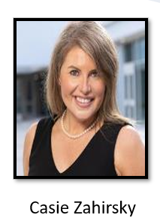
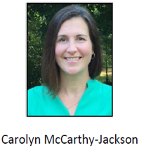
FCS Internship Program Advisors:
Their role is to help bridge the gap with the high school student and the placement site of your desired career field.
Each school is assigned an Advisor, but you could end up working with any of the four.

Slide 3
Internship Advisor and Internship Teacher partnership
Advisor: works with sites to coordinate your internship/grades your site placement interview/communicates with site supervisors/maintain sites/acquires new sites/constantly communicates with teacher
Teacher: leads Internship course/on-campus connection/communicates assignments and due dates/handles attendance issues w/internship/constantly communicates with advisor and students
WE are a partnership!

Slide 4
INTERNSHIP CRITERIA
Applicants must be going into 11th or 12th grade
Applicants must be Gifted
Applicants must have a 90 or above (unweighted) GPA
Interested students are invited to discuss any questions with Ms. McCarthy-Jackson, FCS Gifted Program advisor on Thursday, February 22. She will be in the CHS student center from 8am – 3pm.
Applicants must complete the application and turn in by deadline Thursday, Feb. 29 by 3:30 to Ms. Flores room 1140 or Ms. LeClair-Ash room 2722.
Applicants must give paper copy of teacher recommendation to their selected teacher by Thursday, Feb. 29 at 3:30.
Applicants must attend an in-person interview with Internship teacher.
Applicants must check their FCS and personal emails daily in order to keep current with information.
Applicants must attend an in-person interview with Internship teacher.
Attendance and Discipline will be reported and considered
All applicants who complete the application and interview process will be considered by an Internship committee at student’s school. Submission of an Application does NOT guarantee acceptance.

Slide 5
The Application Process
The Internship Application will be made available to students in January
Students will complete an application and provide the teacher recommendation to the recommending teacher
Internship Teachers will collect hard copies of completed applications and teacher recommendation forms 2/16
Internship Teachers will conduct interviews with individual applicants
Internship Teachers will organize and staff a committee to review applications
Students will be notified of acceptance
Advisors will hold an interview etiquette and resume writing workshop at school to prepare for placements
Advisors will schedule placement interviews with Site Supervisors and students
Advisors will conduct group final interviews at schools based on career interests
Notes:
All interns must complete the application process by the given deadline.
Internship teacher will distribute the link to the application in a variety of ways.
Email
School and/or Dept. Website
Principal Newsletters
School Specific Social Media
Students will access and complete the application, print out, sign/acquire signatures and turn in hard copy.
Students will be responsible for providing teacher recommendation form to recommending teacher (included in application).

Slide 6
Internship Course Expectations
70 hours a semester which equates to AT LEAST 5 hours a week.
Your internship schedule depends on your site’s hours of operation and the nature of your site.
Some places are open on weekends
Some close at 4 pm
First few weeks it is mandatory that you report to your Internship Teacher’s classroom.
Internship placement by 4th week of semester.
Interview w/site supervisor
There are also classroom assignments that you will complete during your internship.
Teacher communicates due dates and deadlines for coursework
You are expected to work around their schedule
This is the MINIMUM requirement.
Think less days more time on each day. Example: Tues and Thursdays 2 to 5
Notes:
The more you put in the more you will get out of it.

Slide 7
TRANSPORTATION
How will you get to your internship?
Be aware if you are not driving yourself to your internship, it is understood that your internship schedule will not be based on the availability of your driver or the availability of the car.
How far are you able to commute for an internship?
Local Area (5-10 mins)
Surrounding Communities (10-20 mins)
Extended Communities and/or Downtown (20+ mins)
This Photo by Unknown Author is licensed under CC BY-NC-ND
Notes:
If you drive GREAT if not YOU MUST talk to your parents about consistent and reliable transportation to and from your site. This can not be predicated on your Parents schedule! Communicating how far you are able to travel in some ways dictates what type of internships I can offer you.

Slide 8
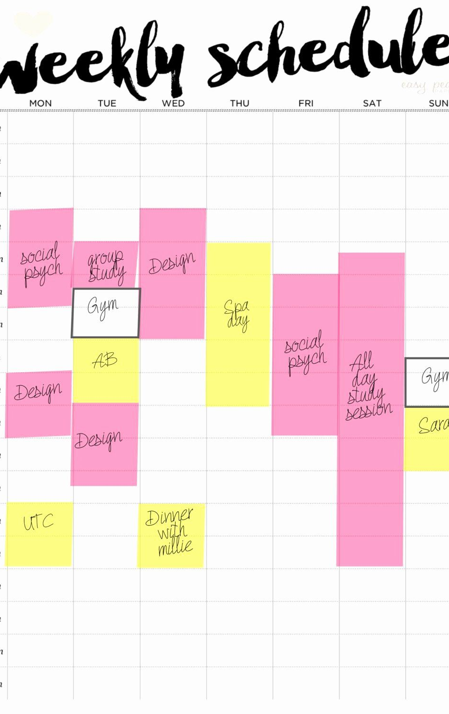
Consider your Schedule
List all extracurricular commitments that you have for the upcoming semester. These commitments cannot interfere with your internship.
Be realistic about how busy you are during the week!
Academic course load
Online classes or dual enrollment
Extracurriculars and Sports
Part time Jobs
Account for travel time to and from the site!
Make a Calendar!
“5 hours per week” is a Minimum!
You must have at least 3 or 4 school days of flexibility
Notes:
Map out a typical schedule so you can see how all your commitments fit in a week.

Slide 9
COMMUNICATION
DUE DATES! Everything we do is time sensitive.
Communication from your Advisors will come via email, text, phone call.
Check email at least twice a day during the placement window.
ALL documents need to be neat, legible, and professional.
Set up voicemail – simple message
Email address needs to be simple and professional
(NOT hotboy59@gmail.com FlyGirl36@yahoo.com)
This Photo by Unknown Author is licensed under CC BY-NC
Notes:
don’t be afraid to talk to me on the phone/there will potentially be follow-up conversations with me;

Slide 10
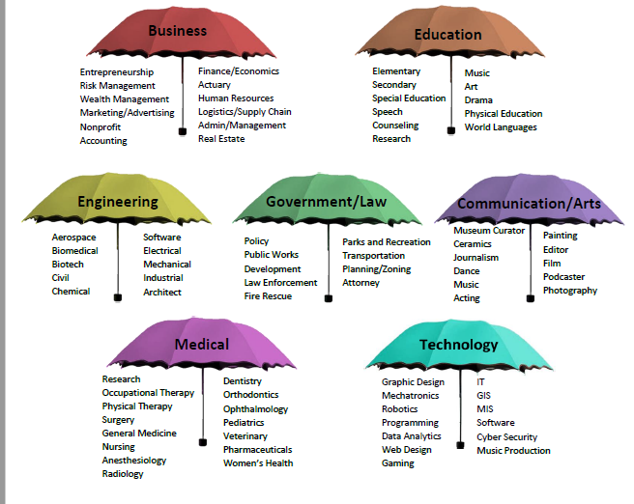
INTERNSHIP UMBRELLAS
Do you know someone in your area of interest?
If you have any leads, or any site contacts all sites must be approved
We cannot guarantee you any specific type of internship, but we can guarantee you an internship under your umbrellas of interest.
Notes:
Be open minded about potential opportunities; We have many sites that are loyal to our program!
veterinarians, engineers, entrepreneurs, physical therapy, occupational therapy, speech therapy, music therapy, hippotherapy, orthopedic surgeons, general medicine, book publishers, journalism, dentists, orthodontists, photography, entertainment, elementary school, middle school, AND SO MANY MORE!

Slide 11
Is internship right for you?
This Fulton County Program has a 30-year legacy all because of the hard work students like YOU put in! DON’T MESS IT UP!
Do you meet the criteria?
Look out for the Application and Deadline.
Be realistic about your commitments and school schedule.
Understand the course expectations
Make certain you have reliable transportation before enrolling in the course.
Look at this as an opportunity to truly explore what it is that you want to do.
Use this as a networking tool and start building connections.
This is a partnership! We are in this TOGETHER!

Slide 12
Thank YOU
Interested students are invited to discuss any questions with Mrs. McCarthy-Jackson, FCS Gifted Program advisor on Thursday, February 22. She will be in the CHS student center from 8am – 3pm.
At any time, reach out to Mrs. Flores or Mrs. LeClair-Ash.
Deadline for applications and giving select teacher a recommendation form is Thursday, Feb. 29 by 3:30PM. Turn in paper applications to Mrs. Flores in room 1140 or Mrs. LeClair-Ash in room 2722. Give teacher recommendation form directly to selected teacher by this date as well.
Cambridge High School Gifted Internship Webpage

